Slide 1
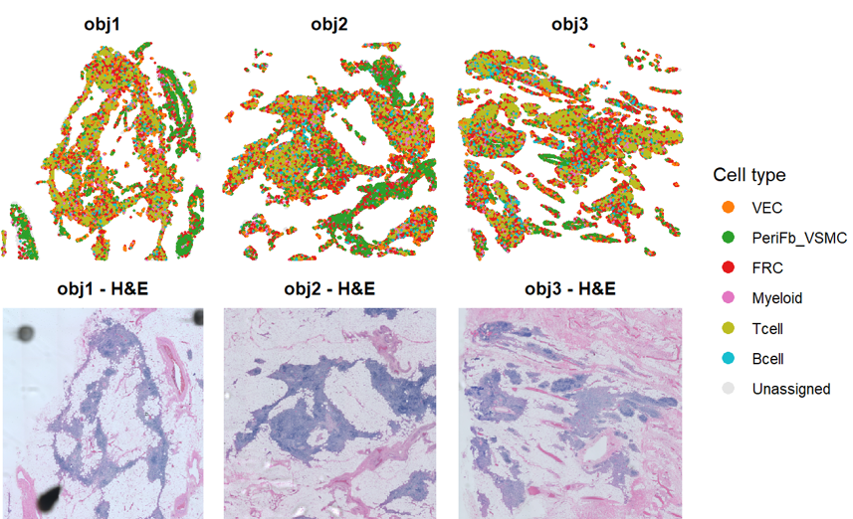
VEC =c("PECAM1","CLDN5","ACKR1","VWF","PLVAP","ICAM2","AQP1"),
PeriFb_VSMC = c("COL1A1","COL1A2","MYL9","LUM","ACTA2","PDGFRB","TAGLN","MYH11"),
FRC = c("CCL19","PDPN","VCAM1","IL33","CLU","IL7","CXCL12","DCN"),
Myeloid = c("LYZ","S100A9","S100A8","CTSS","CST3","GPNMB","CD68","MRC1"),
Tcell = c("CD3D","CD3E","CD3G","IL7R","TRBC1","TRBC2","TRAC"),
Bcell = c("MS4A1","CD79A","CD79B","IGHM","MZB1","XBP1","CD38")

Slide 2
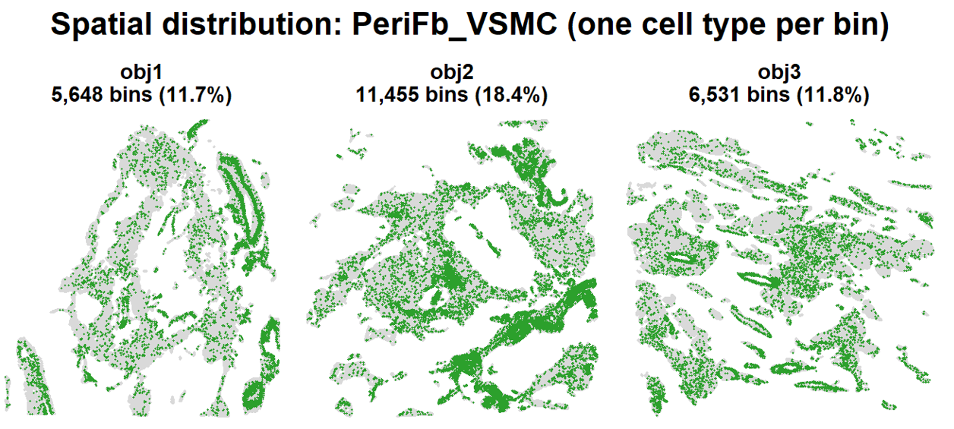
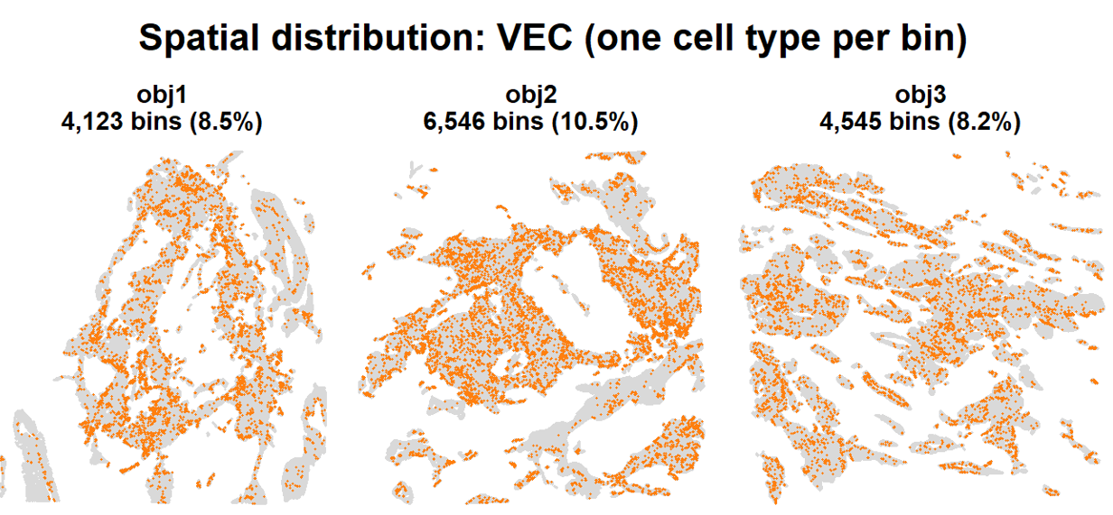
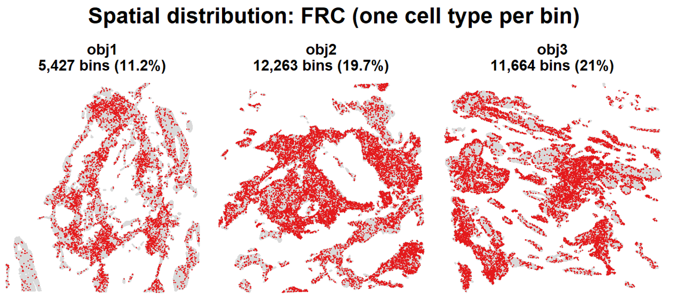
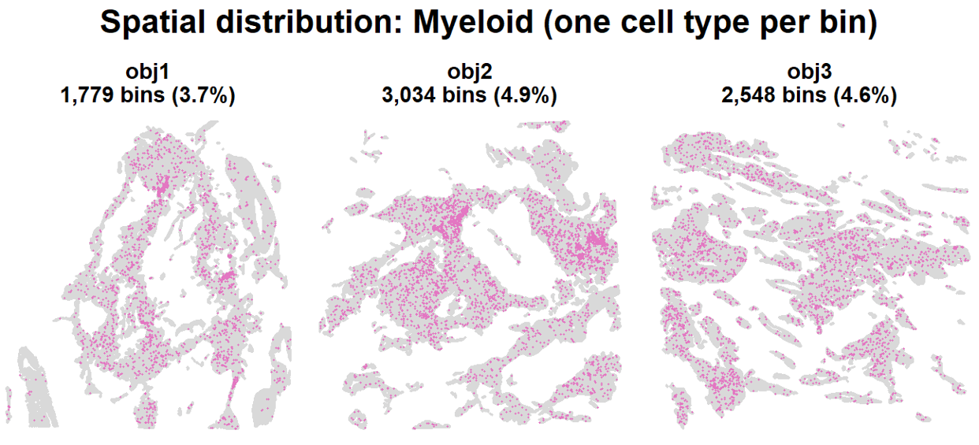
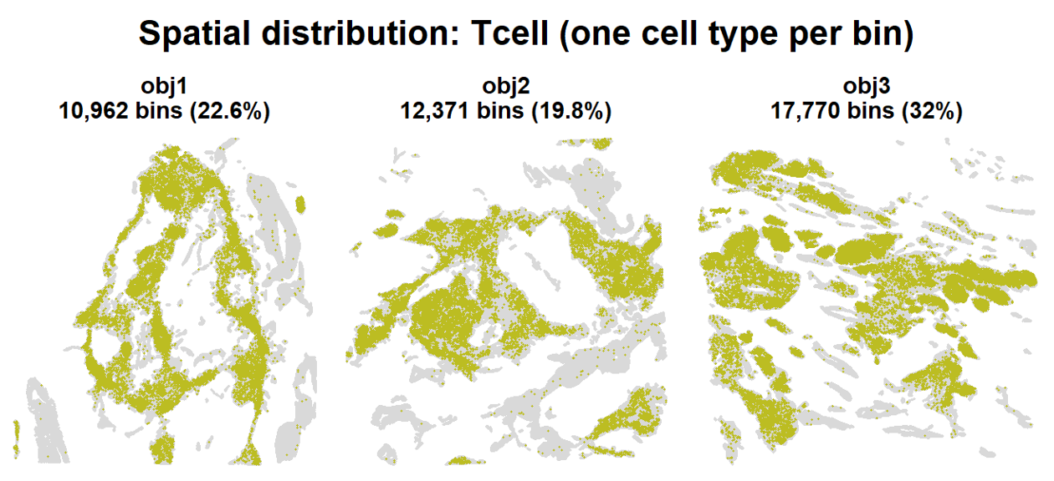
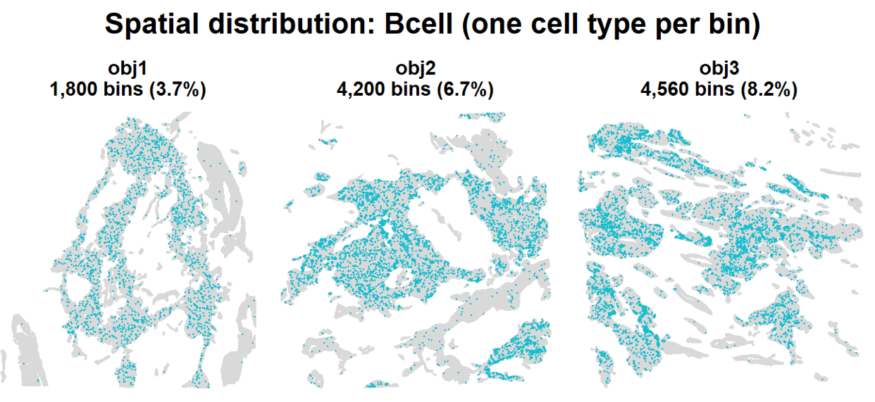

Slide 3
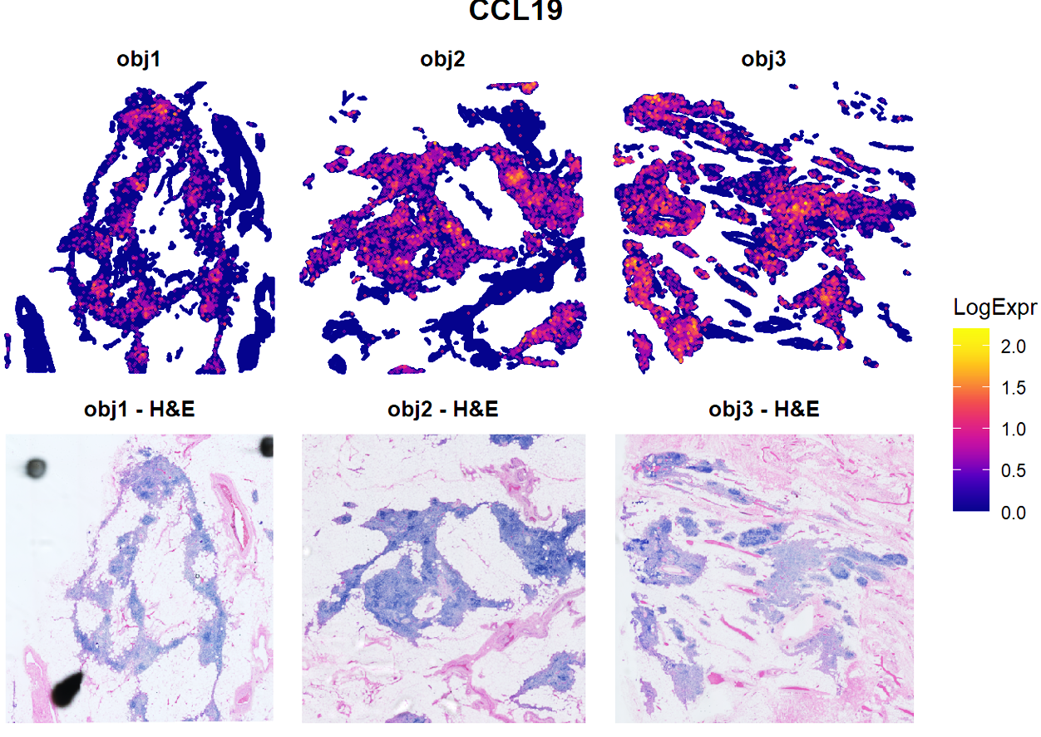
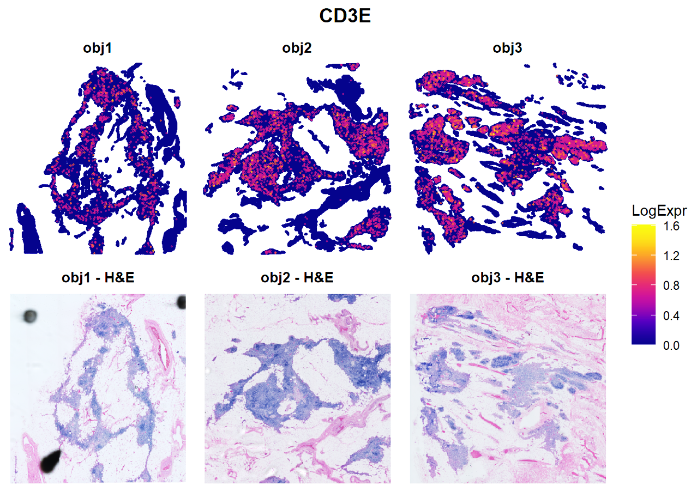
Gene expression:

Slide 4
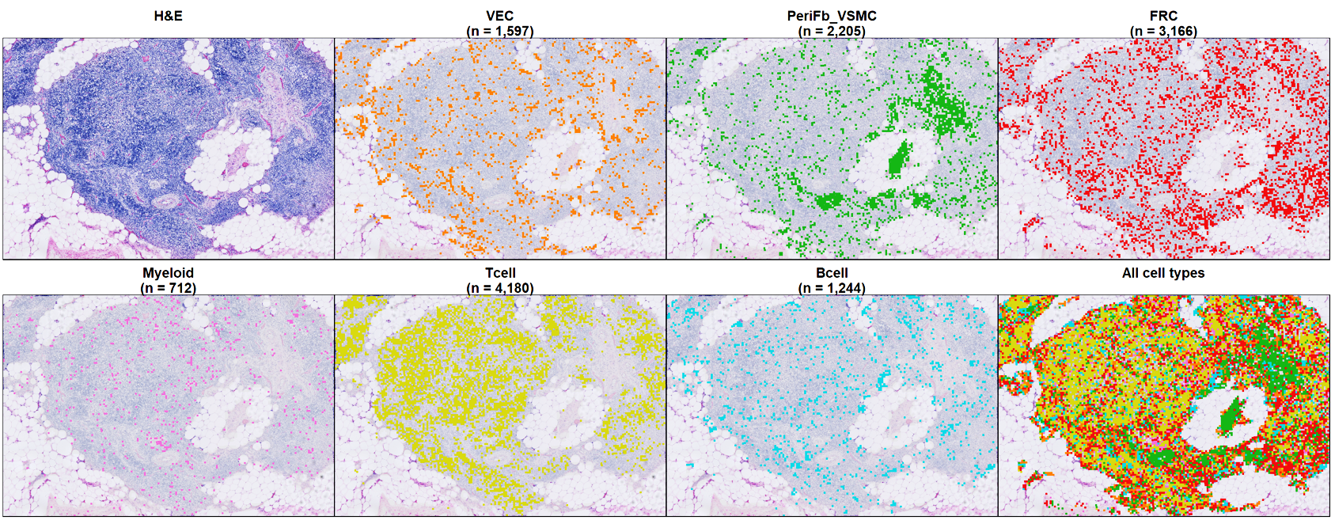
Zoom-in image overlaid with cell projection:

Slide 5
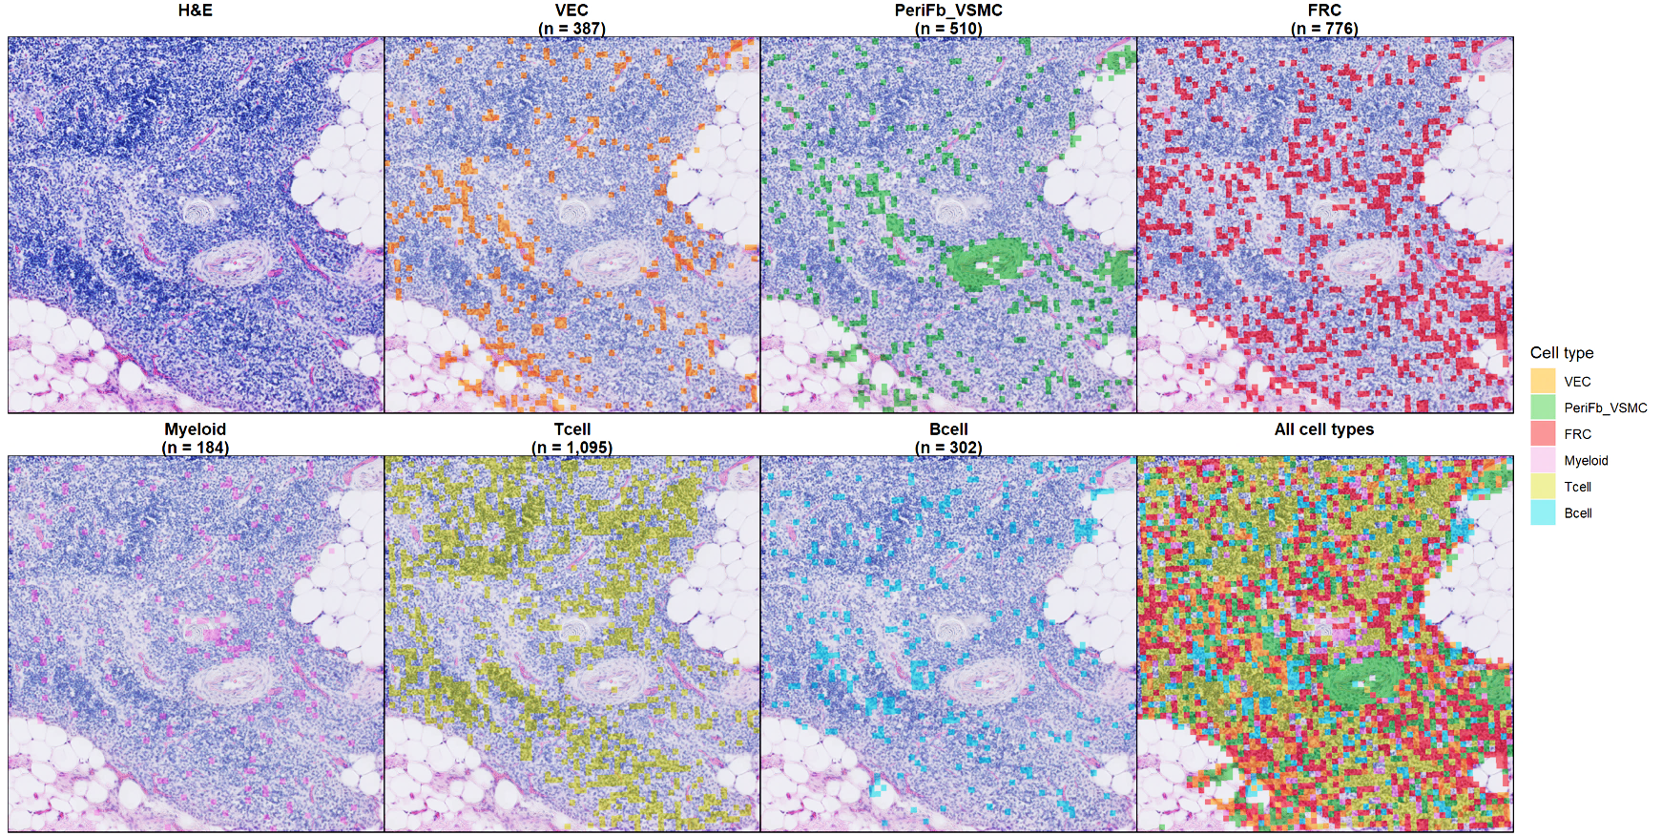
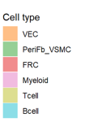
Zoom-in image overlaid with cell projection:

